Slide 1





Modern JavaScript [ ES6++ ]
Writing
READING
SPEAKING
JOKING
// with Chayut Ruksomya

Slide 2
Table of content
What Node JS
NPM and package.json
JavaScript in nullshell
Intro to ES6
Hook into ES6
Babel (update soon)
Webpack (update soon)

Slide 3


Slide 4
JavaScript
Runtime
Outside Web Browser

Slide 5
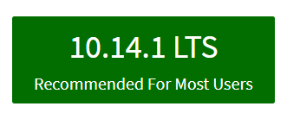
Install Node JS first
https://nodejs.org

Slide 6
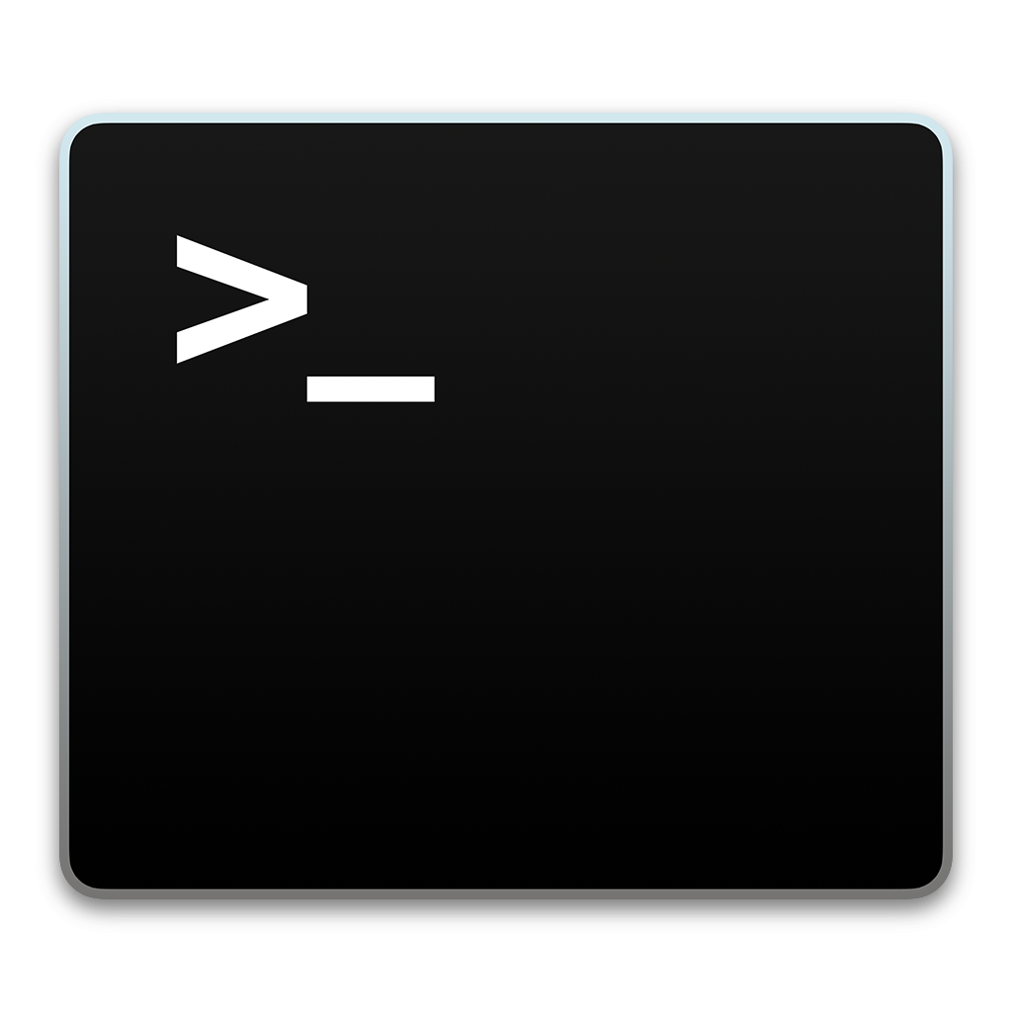
Verify
Installation
node -v

Slide 7
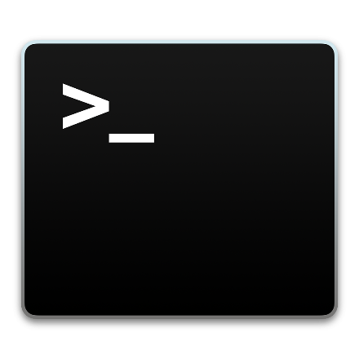
Code Example
CREATING SERVER USING JAVASCRIPT !!
var http = require('http');
var hostname = 'localhost';
var port = 3000;
var server = http.createServer(function (req, res) {
res.statusCode = 200;
res.setHeader('Content-Type', 'text/plain’);
res.end('hello from server!!');
});
server.listen(port, hostname, function () {
console.log('Server running at http://' + hostname + ':' + port);
});

Slide 8

Lab://001

Slide 9

Node Package Manager

Slide 10
The package manager for JavaScript and the world's largest software registry

Slide 11
What is npm?
Use npm to install, share, and distribute code; manage dependencies in your projects;

Slide 12
Verify
Installation
npm -v

Slide 13
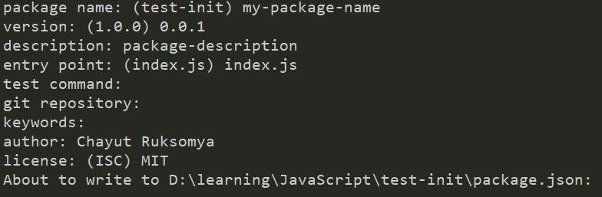
package.json and the very first npm command
npm init
// This command will create package.json file

Slide 14
{ "name": "my-package-name", "version": "0.0.1", "description": "package-description", "main": "index.js", "scripts": { "test": "echo \"Error: no test specified\" && exit 1" }, "author": "Chayut Ruksomya", "license": "MIT" }
package.json
The file in the root of your project source to use npm to install packages that your application requires (node modules).

Slide 15
To install dependency
npm install <package-name>
# or for short
npm i <package-name>
https://www.npmjs.com

Slide 16

Lab://002

Slide 17


ECMAScript 6
ES2015
ECMAScript 2015

Slide 18

Intro to ES6

Slide 19
1. let var const
var -> function () { scope }
let, const -> { block scope }

Slide 20

2. Template String
Normal String -> " " or ' '
Template String -> ` I’m template string ${JS expression} `
` -> Grave Accent

Slide 21
3. Arrow Function => ….
Normal function syntax(s)
setTimeout(function () {
console.log()
}, 1000)
function myFunction(arg) {
console.log(arg)
}
Arrow function syntax(s)
setTimeout(() => {
console.log()
}, 1000)
const myFunction = arg => { console.log(arg)
}

Slide 22


Why Arrow??
this
this.a
function other()
this.b
{
a: 1,
b: 2
}

Slide 23


() => { }
Why Arrow??
this
this.a
this.b
{
a: 1,
b: 2
}

Slide 24

4. rest and spread
const myArray = [5, 4, 3, 2, 1]
console.log([...myArray, ...myArray])
output => [5, 4, 3, 2, 1, 5, 4, 3, 2, 1]

Slide 25
rest and spread
const myObj = {
a:1,
b:2,
c:3
}
console.log({ z: 99, ...myObj })
>>_ output => {z: 99, a: 1, b: 2, c: 3}

Slide 26
5. destructuring
const user = {
id: 0,
firstName: "Bob"
}
const { id } = user
===
const id = user.id

Slide 27
6. Functional programming??
Map() return same length
Filter() return less
Reduce() return something
(more or less or whatever)
Find() return one value

Slide 28

Lab://003

Slide 29

ES6 Advance

Slide 30


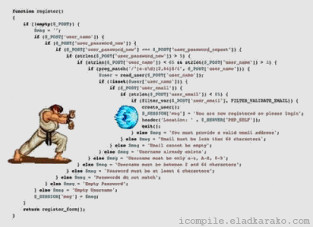
const url = 'https://jsonplaceholder.typicode.com/users'
fetch(url)
.then(response => {
return response.json()
})
.then(myJson => {
console.log(JSON.stringify(myJson));
})
.catch(error => {
console.log(error.message)
})

Slide 31
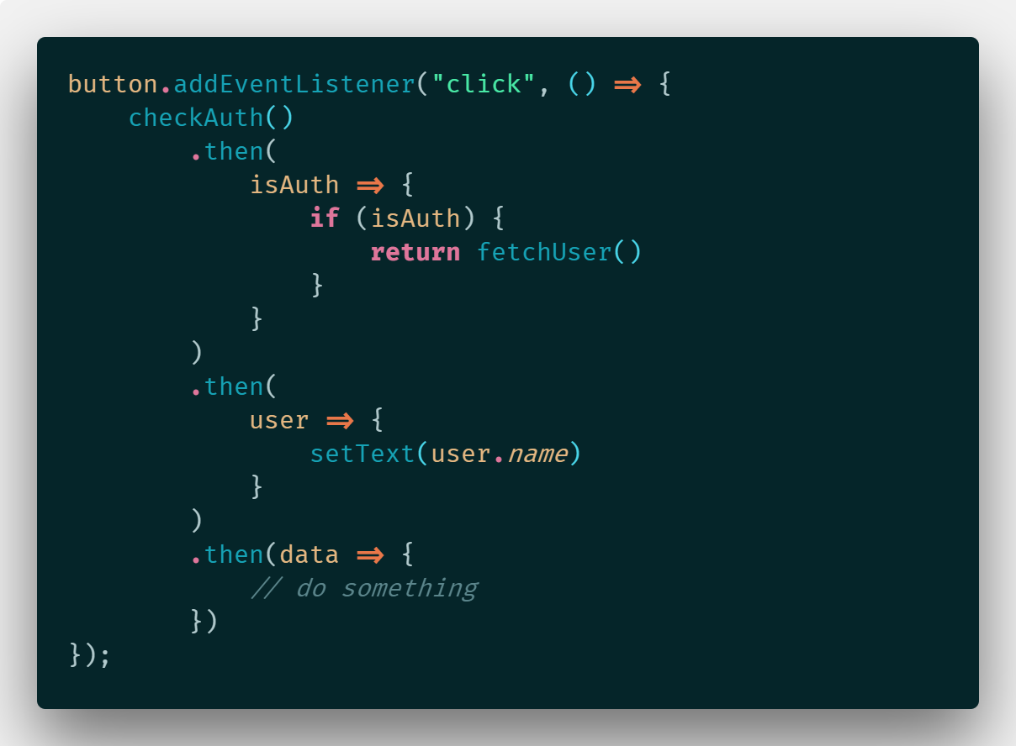
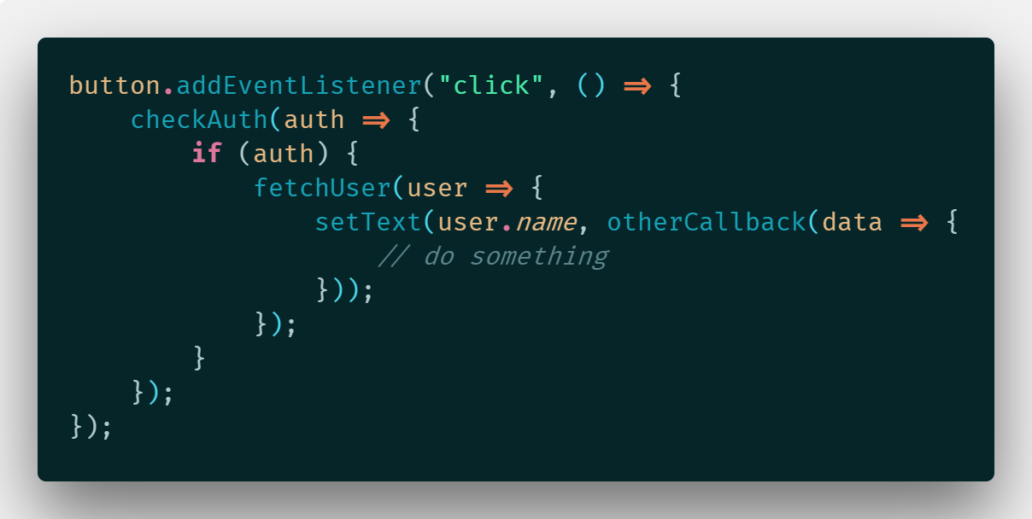
1. Callback VS Promise

Slide 32


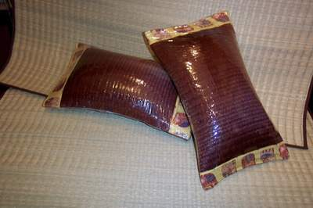





Async Await

Slide 33
Async Await (Seriously)
async function return Promise
await can be written only in async function
await keyword placed in front of Promise
async await are best fit with try catch finally pattern

Slide 34
2. Async Await
const url = 'https://jsonplaceholder.typicode.com/users'
async function fetchData(url) {
try {
const response = await fetch(url)
const myJson = await response.json()
console.log(JSON.stringify(myJson, null, 2))
} catch (error) {
console.log(error.message)
}
}

Slide 35
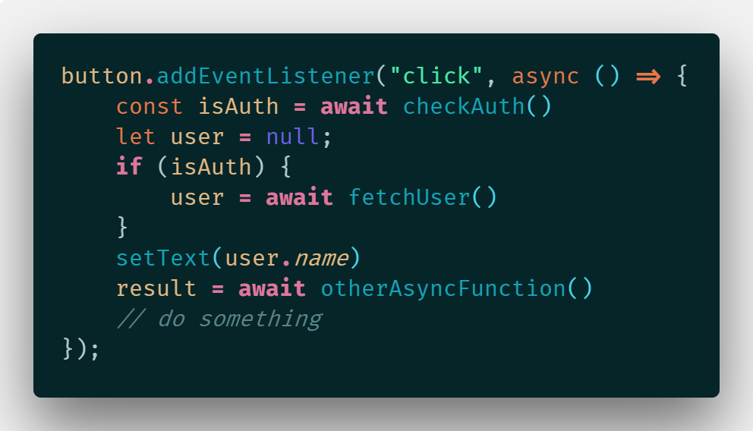
3. Promise to Async await

Slide 36
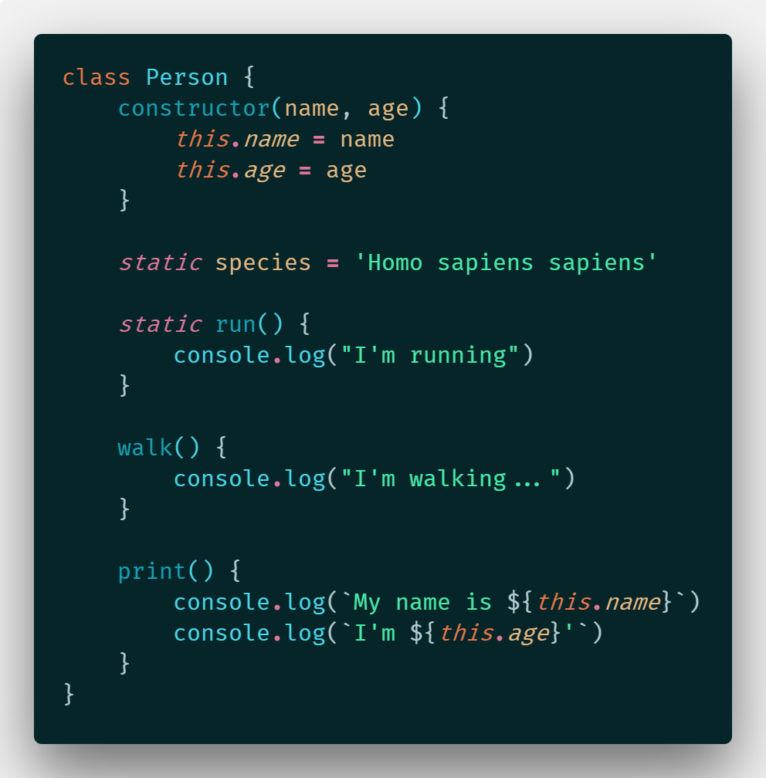
4. Class

Slide 37

Lab://004

Slide 38
Day one End

Slide 39
Transpilers
Polyfill

Slide 40
Transpilers
New ES6+ Syntax
Old ES5 Syntax
Polyfill
Fill-up a Prototype of any Objects with versatile function

Slide 41

Installation with npm (mutiple dependency)
"devDependencies": {
"@babel/cli": "^7.1.5",
"@babel/core": "^7.1.6",
"@babel/preset-env": "^7.1.6"
},
"dependencies": {
"@babel/polyfill": "^7.0.0"
}
npm install [dependencies with white space]
npm install @babel/cli @babel/core @babel/preset-env --save-dev
npm install @babel/polyfill

Slide 42
Configurations
{
"presets": [
"@babel/preset-env"
],
"sourceMaps": "inline"
}
.babelrc
package.json
"browserslist": "IE 11"

Slide 43

Workflow with Babel transpilers and node JS
Dev
In
src
Build
to
dist

Slide 44

src folder and dist folder
src/index.js
dist/index.js
"use strict";
[1, 2, 3].map(function (n) {
return Math.pow(n, 2);
});
[1, 2, 3].map(n => n ** 2)
browser-compatible

Slide 45
Import export modules (how to)
import.js
mather.js
import mySquare,{
divide
}
from ‘./mather'
export function divide(x) {
return x / 2
}
export function add(x) {
return x++
}
export default function square(x) {
return x * x
}
mySquare(2)
divide(2)

Slide 46
But!! Indeed You can not use Import export modules in web browser

Slide 47

Lab://005

Slide 48


See MODULE BUNDLER soon!!

Slide 49
Thank you ;)

